Slide 1
TRF-sertifisering
Polio og Rotary - status
RRFC Ingrid Grandum Berget
Notes:
This presentation presents an overview of the current status of global polio eradication efforts and Rotary’s role in it. These past 12 months have been a period of major achievement, challenge and change.

Slide 2
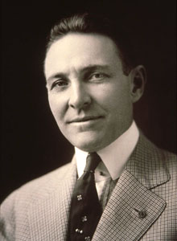
The Rotary Foundation
Arch Klump 1917
Å hjelpe Rotary til å gjøre noe godt i verden i form av veldedighet, utdannelse og andre samfunnsgavnlige servicetiltak
Aktivt fra 1930
Notes:
Det er ikke nok å ha entusiasme og engasjement for å nå Rotarys mål om internasjonal forståelse og fred i verden.

Slide 3
Fokusområder
Fred og konfliktforebygging/løsning
Sykdomsforebygging og behandling
Vann og sanitær
Barn- og mødrehelse
5. Grunnutdanning og leseferdighet
6. Økonomi- og samfunnsutvikling

Slide 4

World peace center
1.Mastergrad
Internasjonale studier, Offentlig administrasjon, Bærekraftig utvikling, Fredsstudier, Konfliktløsning eller
tilsvarende.
2. Professional development certificate in peace and conflict resolution (3 mndr).

Slide 5

RI’s hovedmål:

Slide 6
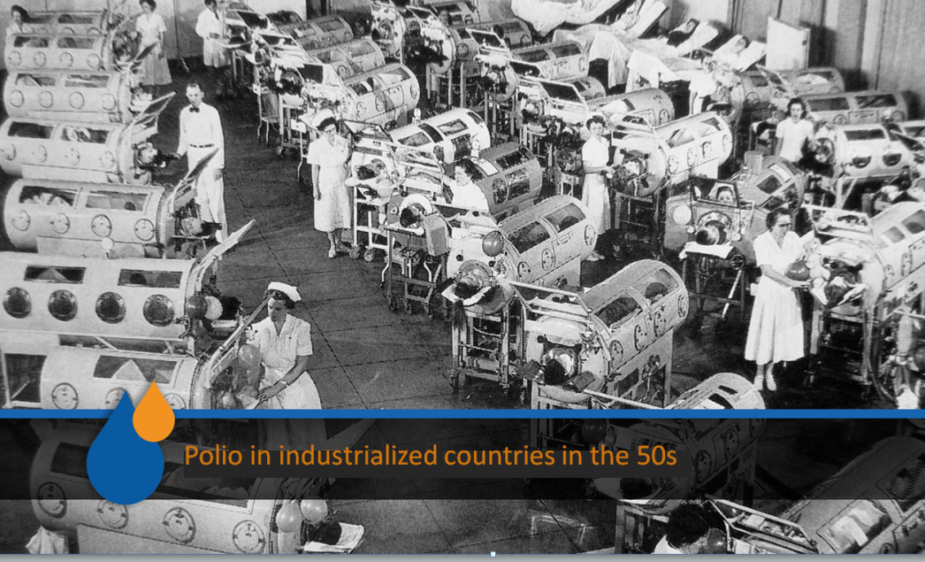

Slide 7
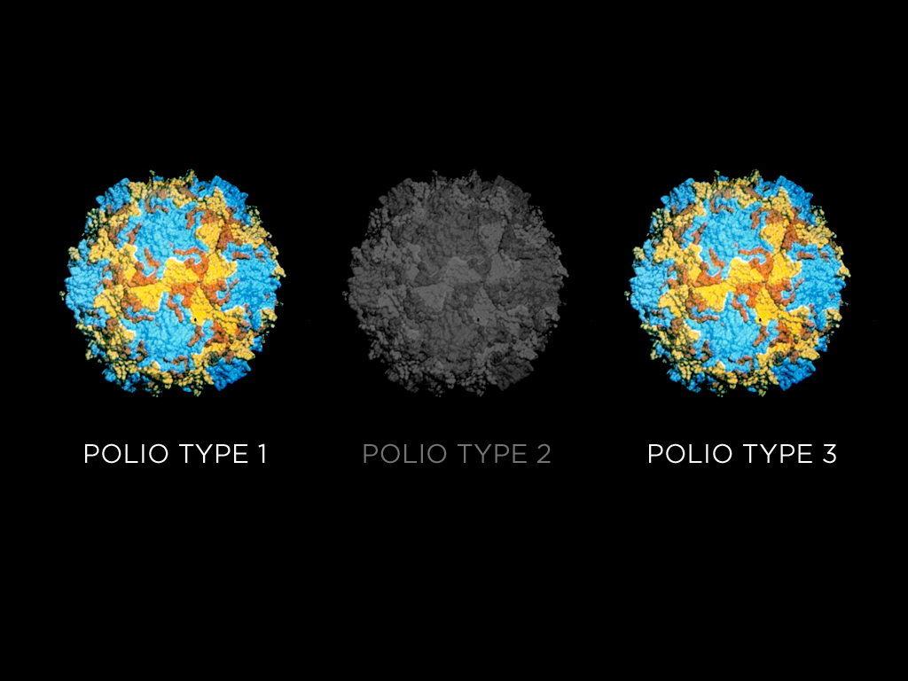
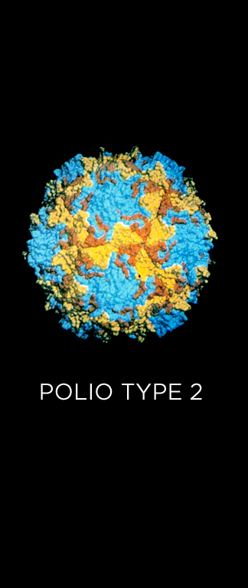
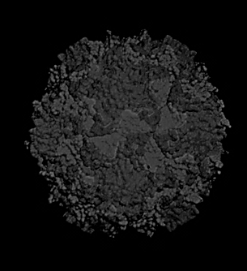


Notes:
After a very successful immunisation day in the Philippines in 1979 Rotary carefully planned and launched the PolioPlus program in 1985, when the poliovirus was circulating in 125 countries, paralyzing or killing 1,000 people a day.
Today polio cases have been reduced by 99 percent with only 223 cases reported worldwide in 2012. Only three countries have never stopped the transmission of the wild poliovirus-- – Pakistan, Afghanistan and Nigeria.
In 1985 three types of poliovirus paralyzed children in over 125 countries. The type 2 wild poliovirus [click] paralyzed its last victim in India in 1999 and for the first time in history there has not been type 3 poliovirus [click] anywhere in the world for nearly a year.

Slide 8
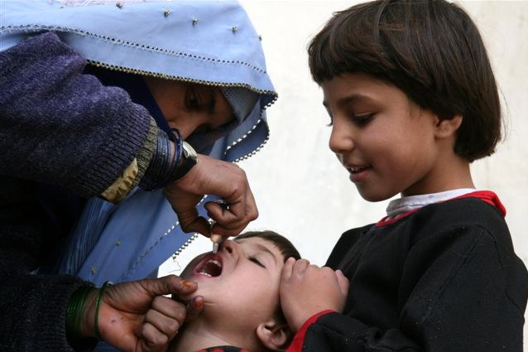

Slide 9

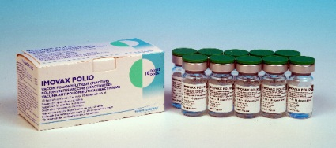
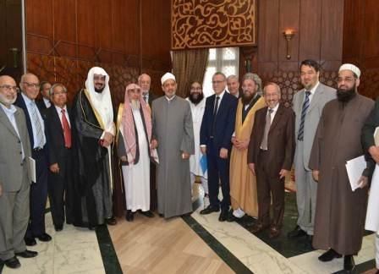
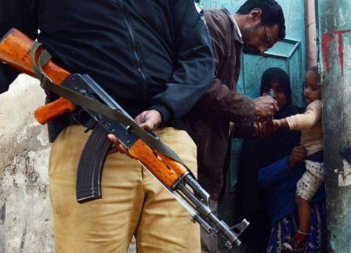

Notes:
The challenges we face are daunting, challenges like the horrific attacks on health workers in Nigeria and Pakistan and outbreaks in the Horn of Africa. But we have faced numerous challenges before, including conflict, yet we continue to make progress.
Part of the new Endgame Strategic Plan includes using the inactivated polio vaccine – or IPV – which will be introduced into routine immunization programs globally to significantly boost the immunity of children against polio.
New religious alliances like the Global Islamic Advisory Council led by Al Azhar University of Egypt will work to ensure that all parents understand their obligation to vaccinate their children and that all communities condemn any attack on health workers.
And new strategies will reach children in areas where health workers are being attacked and killed.

Slide 10
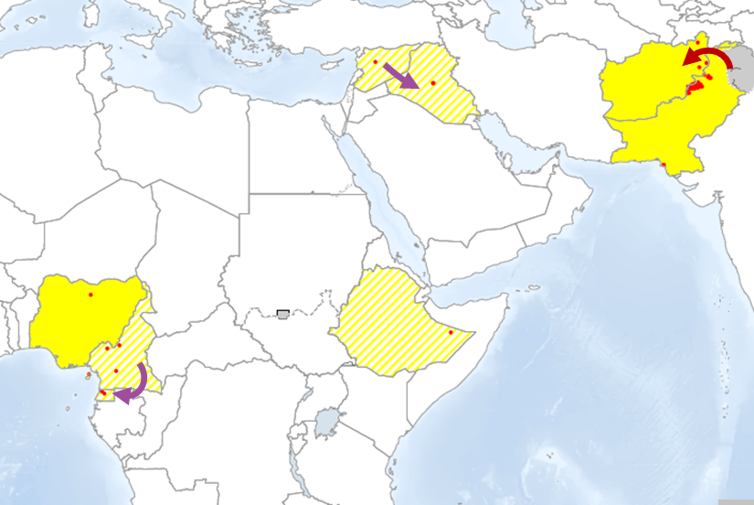
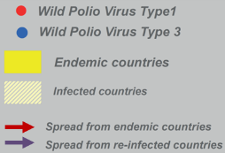
International Spread of Polio, 2014
Syria to Iraq
Cameroun to Eq. Guinea
PAK to AFG

Slide 11
Anbefalinger 8. august 2014
Både Pakistan og Equatorial Guinea har eksportert virus internasjonalt siden mai.
Polio trives i konfliktområder
Tiltak gjelder alle reisende til og fra Pakistan, Syria, Equatorial Guinea, Cameroon, Afghanistan, Etiopia, Irak, Israel, Somalia og Nigeria

Slide 12
GOVERNMENTS
OF THE WORLD
Notes:
The partnership with the goal of eradicating polio was formed in 1988 and is called The Global Polio Eradication Initiative or GPEI.
Rotary works with the World Health Organization, UNICEF and the U.S. Centers for Disease Control and Prevention, and with the governments of the world, both in the polio affected and donor countries, and with the support of the Bill & Melinda Gates Foundation, among other partners who have joined this successful global effort.

Slide 13
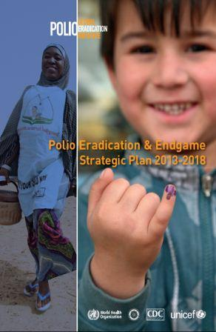
Endgame Strategic Plan
Polio Eradication &
Endgame Strategic Plan
2013-18
Notes:
In May 2013 the World’s Ministers of Health gathered in Geneva and launched a bold new Polio Eradication & Endgame Strategic Plan’ that was developed by the polio partners and Rotary over the previous twelve months. The funding requirement to fully implement the plan is significant: US$5.5 billion.
13

Slide 14
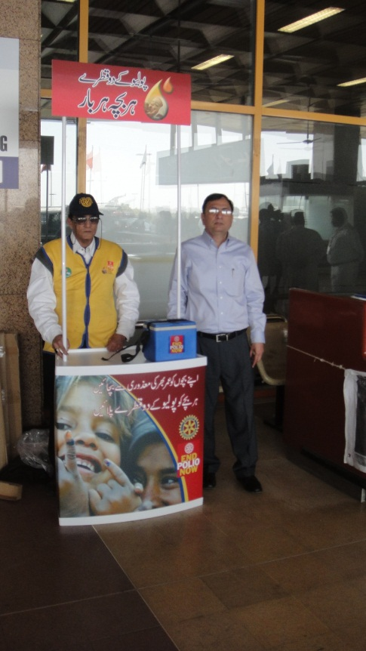

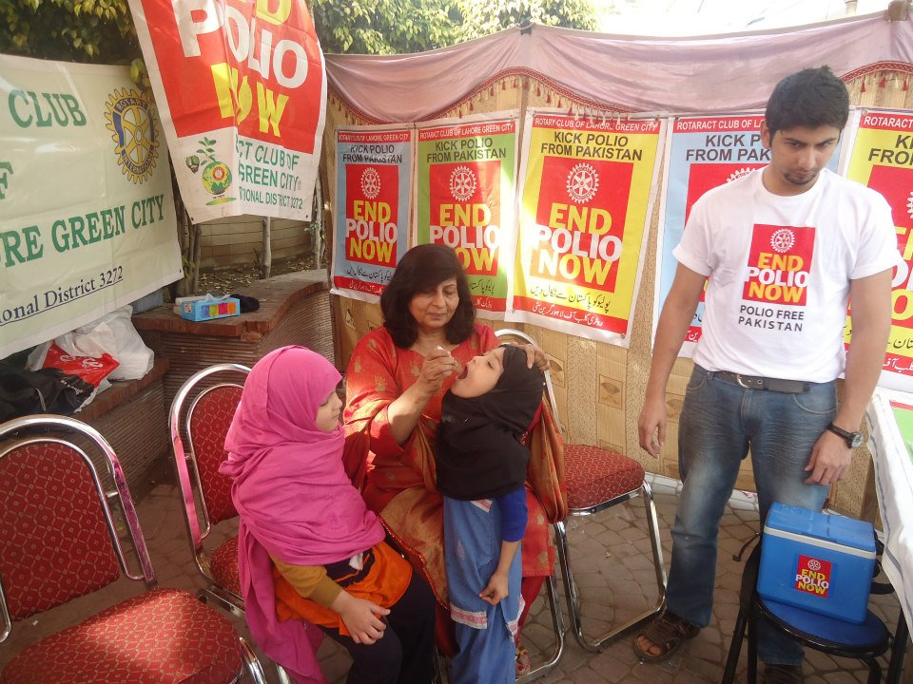
Notes:
Rotarians are also increasing their engagement on the ground. In Pakistan one of the key innovations has been the development of Polio Resource Centers and the establishment of permanent immunization posts in airports and transit vaccination posts at border crossings where the virus often gets transmitted between Pakistan and Afghanistan. To help in this work, Rotarians are partnering with multinational companies such as Coca Cola.

Slide 15
HVORFOR SKAL VI UTRYDDE POLIO
Den mennesklige kostnad
Det er oppnåelig
Det er en god investering
Det styrker helsevesenet
Den setter en standarden

Slide 16


Financing the endgame plan
Ny utfordring – nye muligheter
Fra 2013 to 2018, blir hver US$1 million som Rotary bidrar med I direkte støtte til polio vaksinering (begrenet oppad til US$35 million) matchet med US$2 million fra the Gates Foundation.
Notes:
One of the forces that will get us across the finish line is Rotary’s focused financial support, which will be magnified with an agreement with the Bill & Melinda Gates Foundation. From 2013 to 2018, every US$1 million that Rotary commits in direct support for polio immunization (up to US$35 million) will be matched by an additional US$2 million from the Gates Foundation.

Slide 17
SLIDE TITLE

